Slide 1


Go to Lake Toba easier!
FUTURE Program 4.0 – Phase 2

Slide 2
OUR TEAM
Sogumontar Hendra
Syntia
Backend devs
Frontend devs
- FUTURE Medan -

Slide 3
Why
Danau Toba?

Slide 4
- Joko Widodo, 2019
‘‘Sudah berpuluh tahun lamanya Danau Toba, khususnya dermaganya tak tersentuh pembangunan. Padahal, Danau Toba memiliki potensi yang besar.’’

Slide 5

20 Dec’19 – 1 Jan’20 tourists who came to Samosir reached 35,120 people Samosir got Rp 212,494,000 for 11 days.

Slide 6
But…

Slide 7
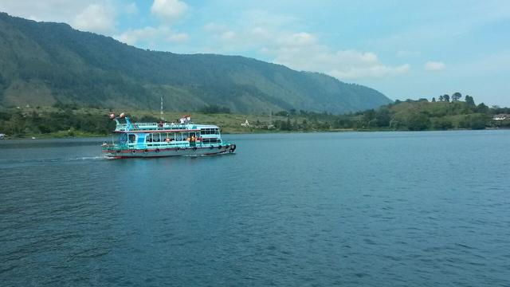
One of the most crucial problems in the development of tourism in Lake Toba is The lack of connecting infrastructure connected with tourist mobility (accessibility)
- Asisten Deputi Bidang Pelayaran, Perikanan dan Pariwisata Kemenko Maritim
(Rahman Hidayat), 2017

Slide 8
What is the
Solution?

Slide 9

GOTOBA
Mobile-friendly platform connected with people around Lake Toba, easier your travel with ticket bundling and itinerary planner.

Slide 10

BENEFITS
Itinerary Planner
Bundling Ticket
Information
Plan your trip and save it to pdf
Buy ticket and show it using QR code
Get information easier in our website

Slide 11
How it works
?

Slide 12
User (Customer)
I can view and search information about Lake Toba.
I can view web gallery.
I can buy and use ticket.
I can make my itinerary plan and print it to pdf.
I can show my order history.

Slide 13
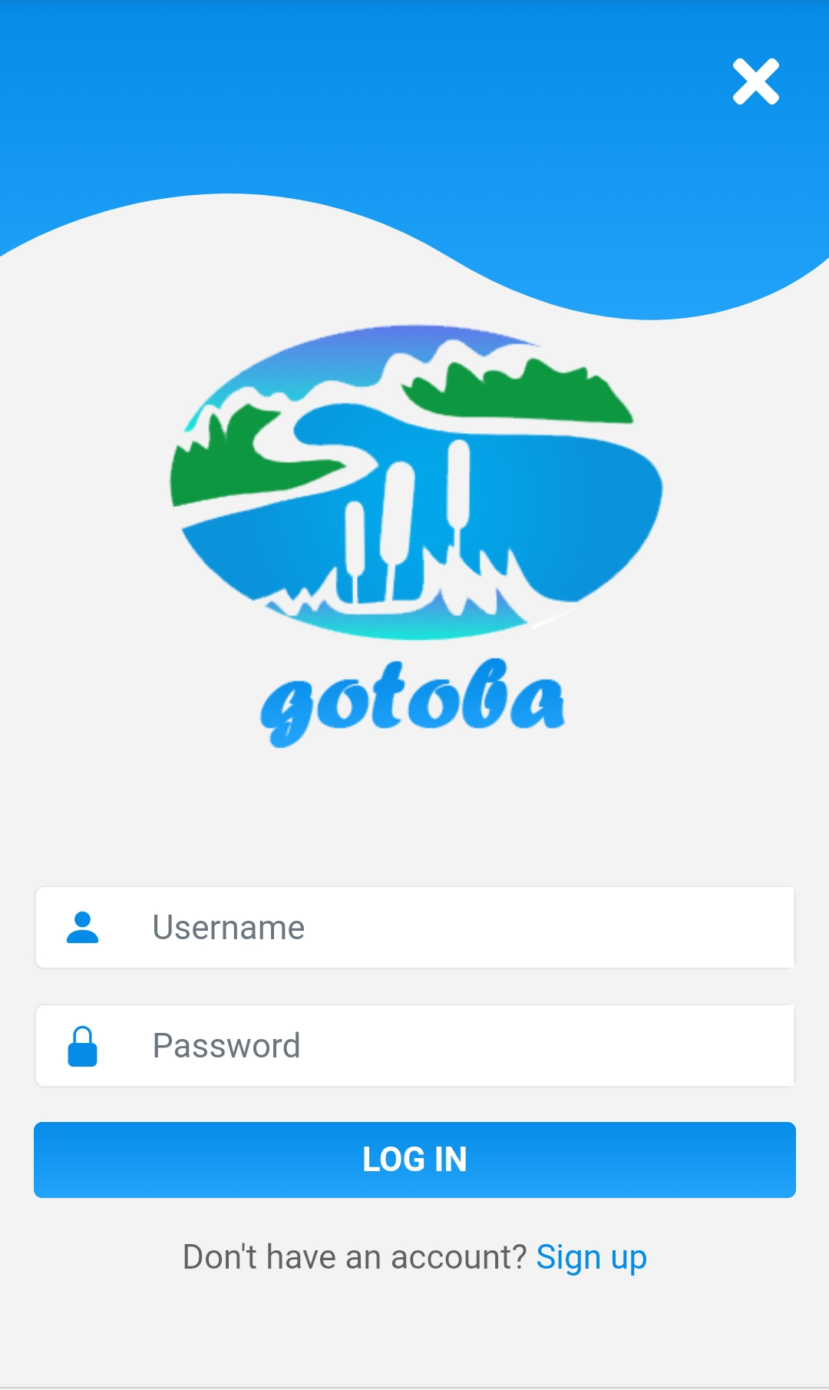
Login
Log into your Account

Slide 14
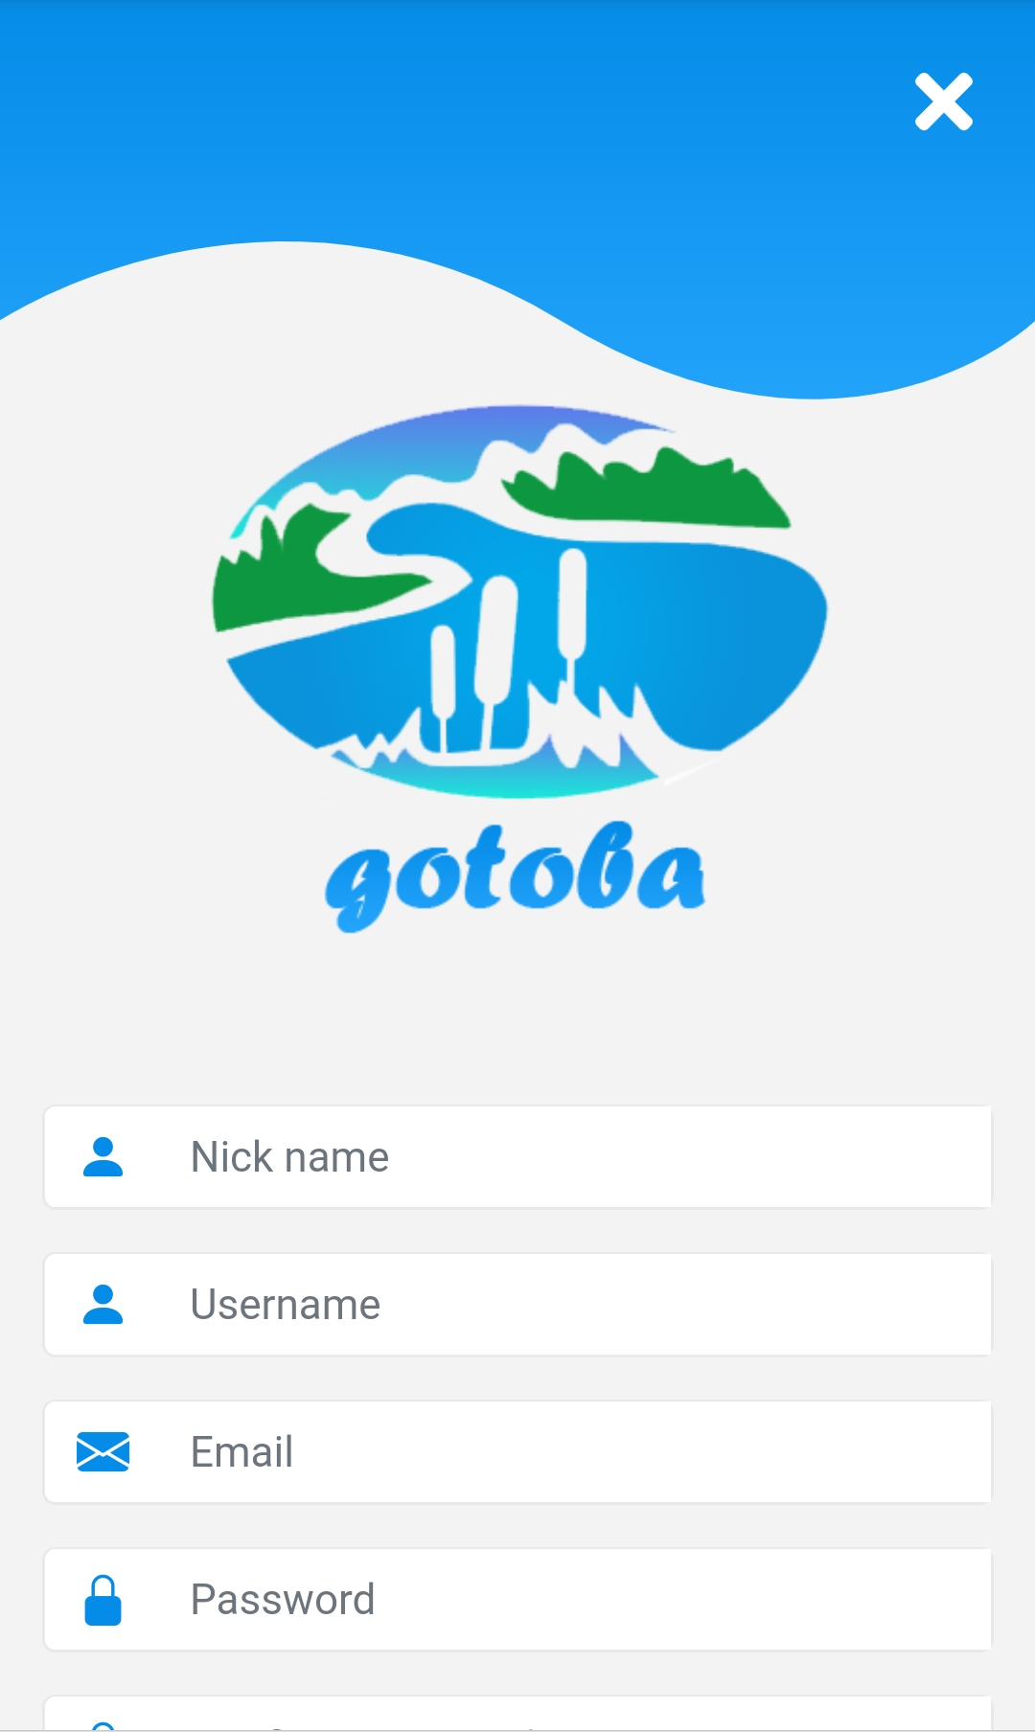
Sign up
Register a new Account

Slide 15
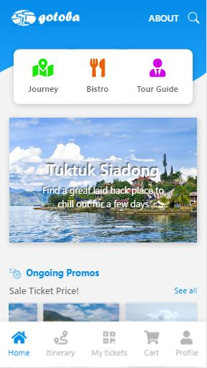
Home
Landing page

Slide 16
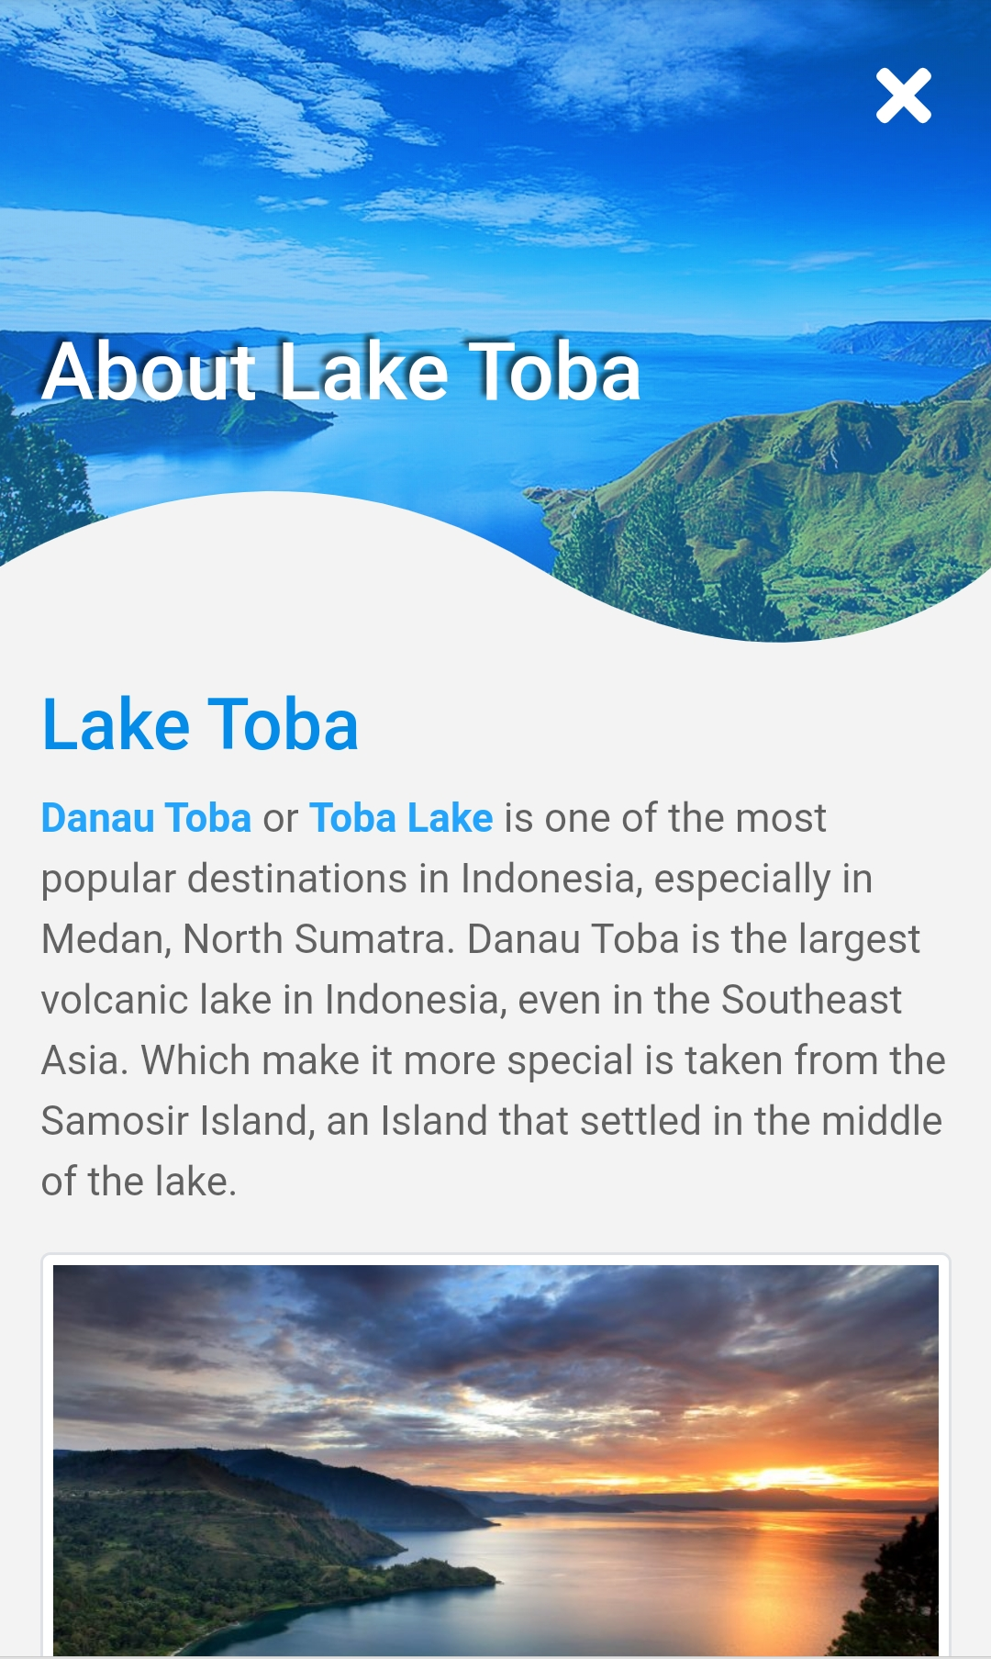
About
More about Lake Toba

Slide 17
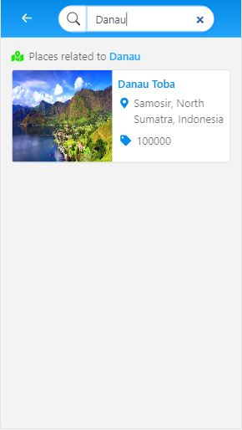
Search
Search for itinerary/restaurant

Slide 18
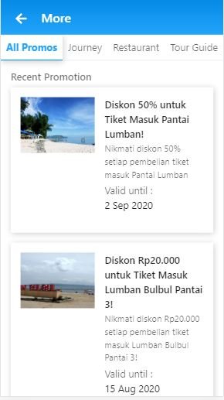
More
Show all promotions

Slide 19
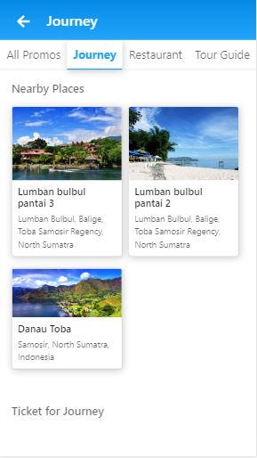
Journey
Show all Journey

Slide 20
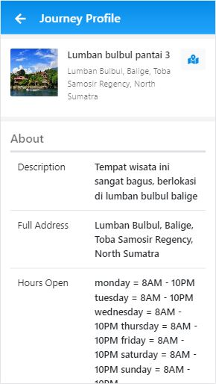
Journey Profile
Show a Journey Description

Slide 21
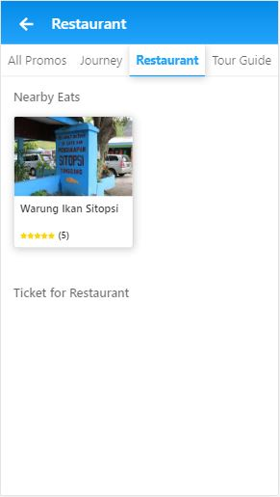
Restaurant
Show all Restaurant

Slide 22
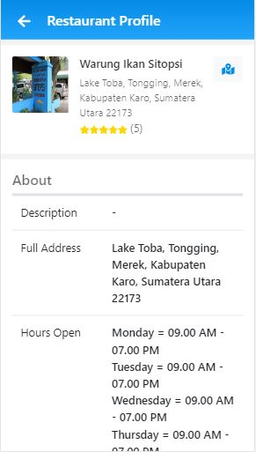
Restaurant Profile
Show a Restaurant Description

Slide 23
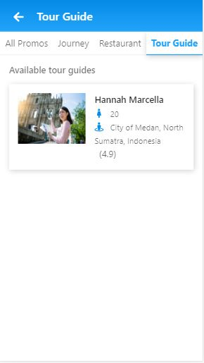
Tour Guide
Show all Tour Guide

Slide 24
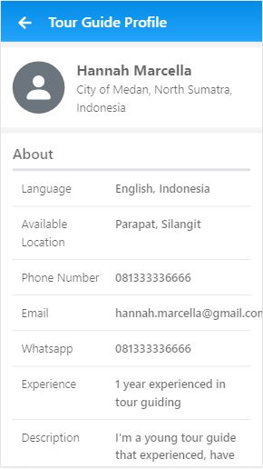
Tour Guide Profile
Show a Tour Guide Description

Slide 25
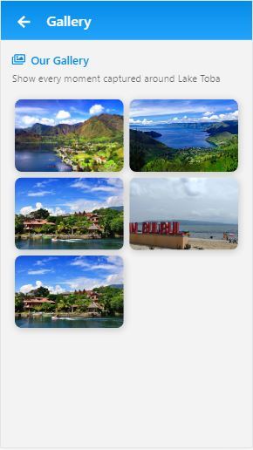
Gallery
Show all Gallery Photos

Slide 26
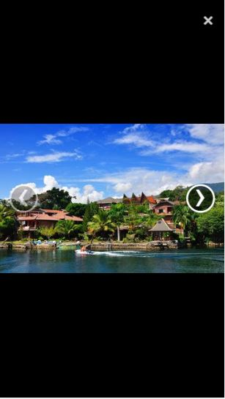
Gallery Photo
Show Gallery Photo

Slide 27
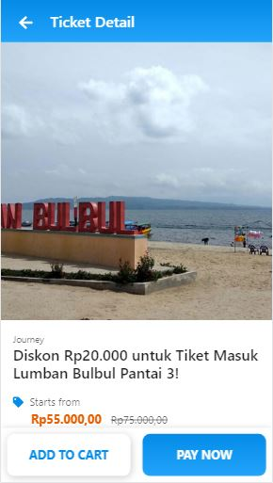
Ticket
Show Ticket Description

Slide 28
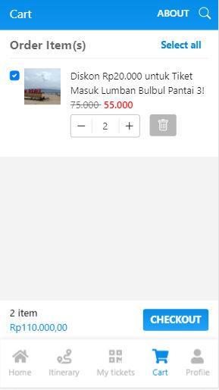
Cart
Show all Saved Ticket to Order

Slide 29
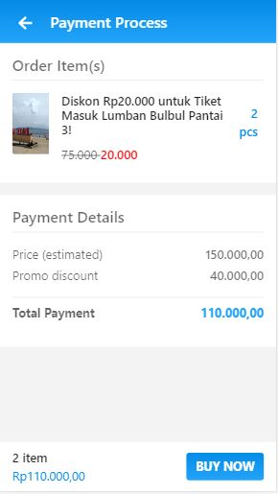
Payment
Show Order Detail before make Payment

Slide 30
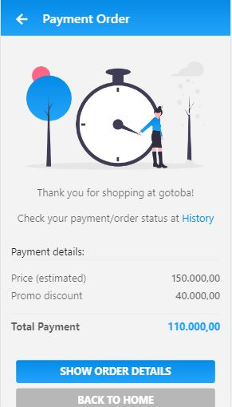
Thanks for Order
Show that an order has been Paid

Slide 31
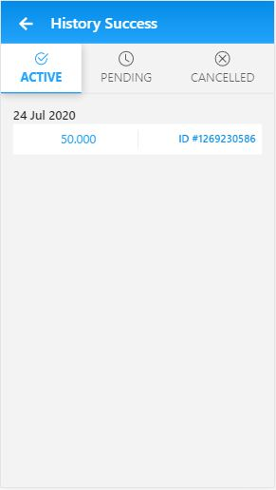
History
Show All Payment History

Slide 32
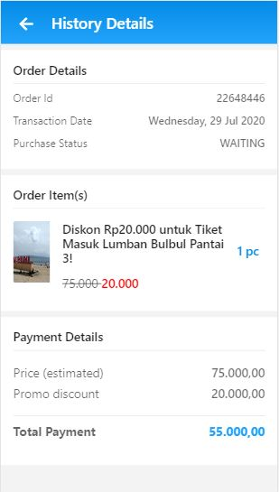
History Detail
Show Payment Detail

Slide 33
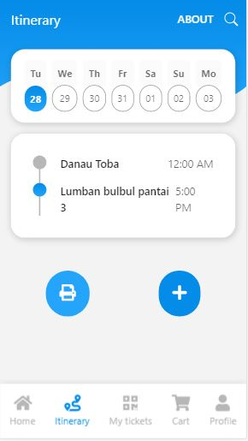
Itinerary
Show Itinerary Timeline in this Week

Slide 34
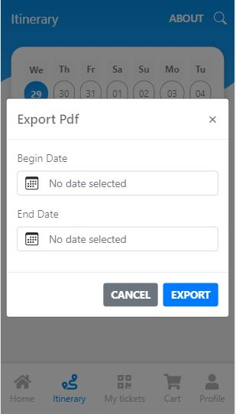
Export to PDF
Export saved Itinerary to PDF

Slide 35
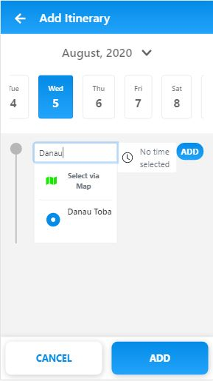
Add Itinerary
Add Itinerary Timeline

Slide 36
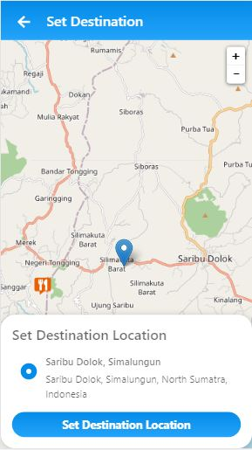
Set Destination
Set Itinerary Destination from Map

Slide 37
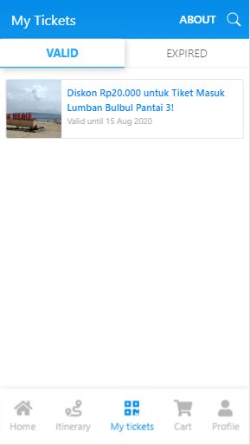
My Tickets
Show all Valid and Expired Tickets

Slide 38
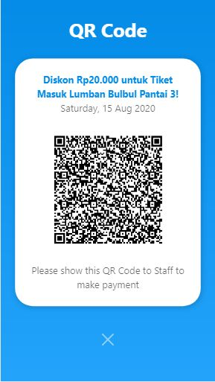
Show QRCode
Show Ticket QR Code

Slide 39
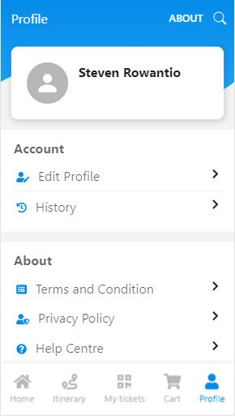
Profile
Show Profile and more Menu

Slide 40
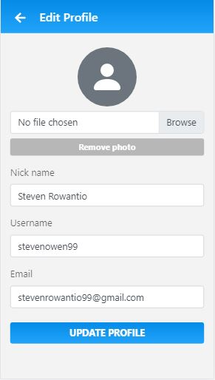
Edit Profile
Edit User Profile

Slide 41
Merchant
I can accept order from my ticket.
I can update journey/restaurant information.
I can scan and use my ticket QR code.

Slide 42
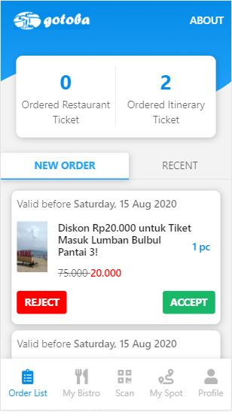
Order List
Show Order to the Merchant

Slide 43
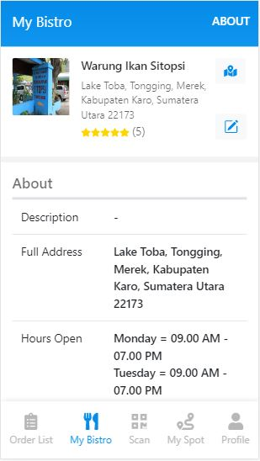
My Bistro
Show Bistro Description

Slide 44
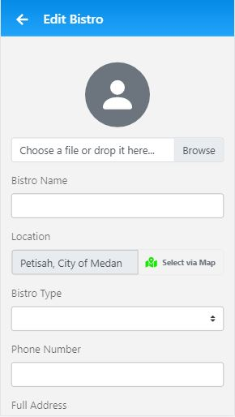
Edit Bistro
Edit Bistro Profile

Slide 45
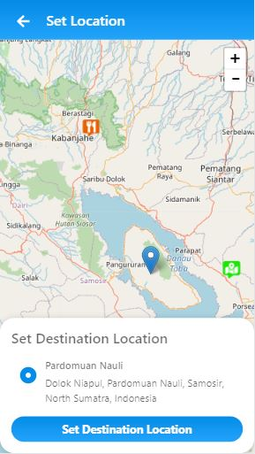
Set Location
Set Bistro/Journey Location from Map

Slide 46
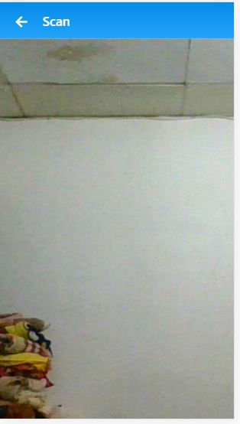
Scanner
Show QR Scanner

Slide 47
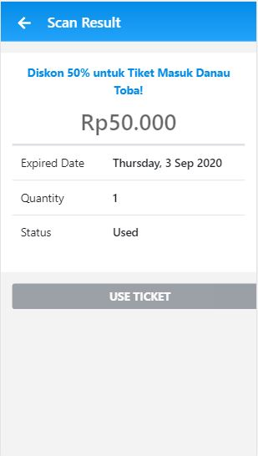
Scan Result
Show Scan QR Code Result

Slide 48
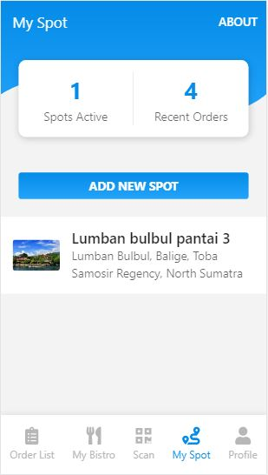
My Spot
Show All Merchant’s Spot

Slide 49
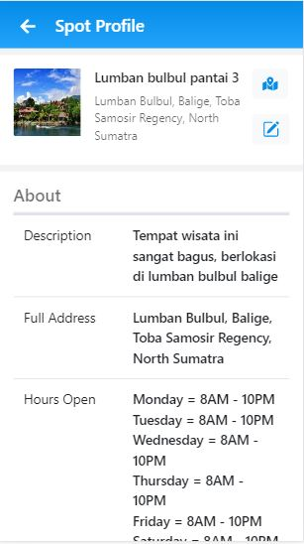
Spot Profile
Show a Spot Description

Slide 50
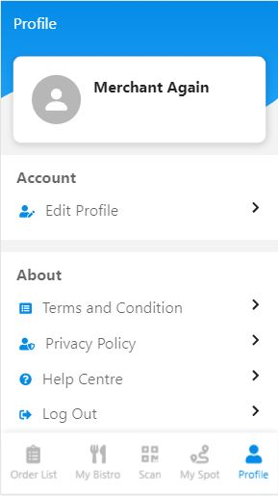
Merchant Profile
Show Merchant Profile and some Menu

Slide 51
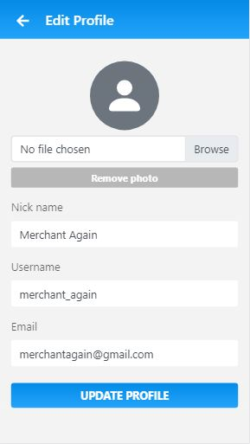
Edit Profile
Edit Merchant Profile

Slide 52
Admin
I can access master data.
I can manage gallery data.
I can block user/merchant.
I can add information about Lake Toba.

Slide 53
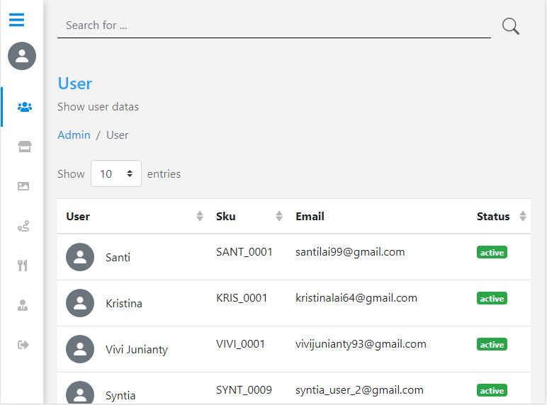
User Data
Show User Master Data

Slide 54

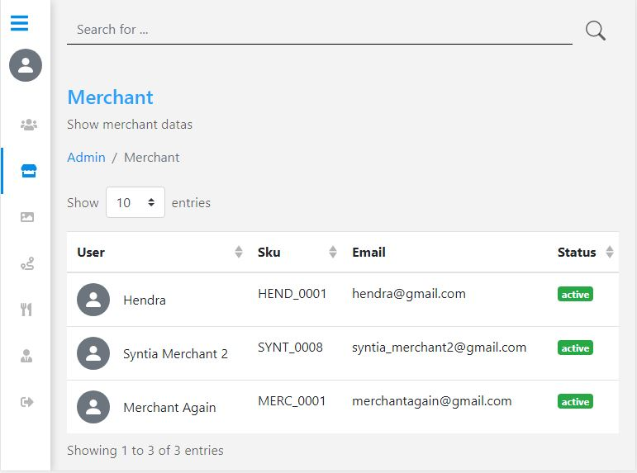
Merchant Data
Show Merchant Master Data

Slide 55
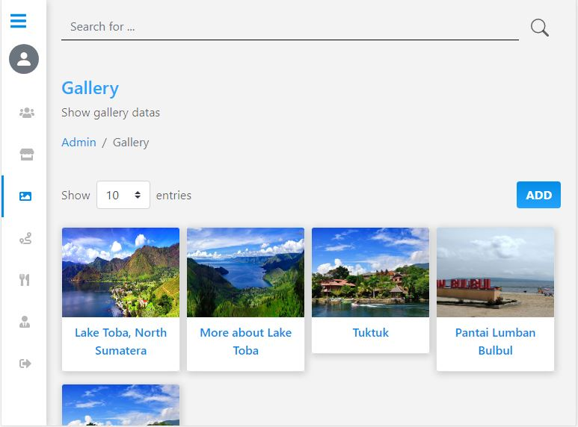
Gallery Data
Show Gallery Master Data

Slide 56
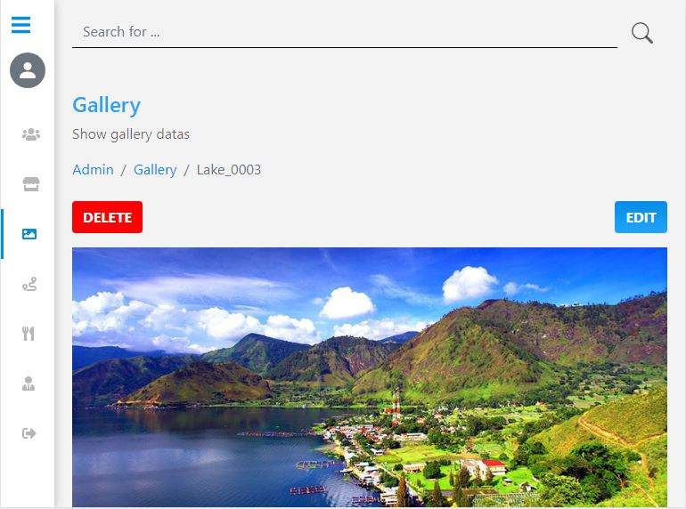
Gallery Detail
Show Gallery Detail

Slide 57
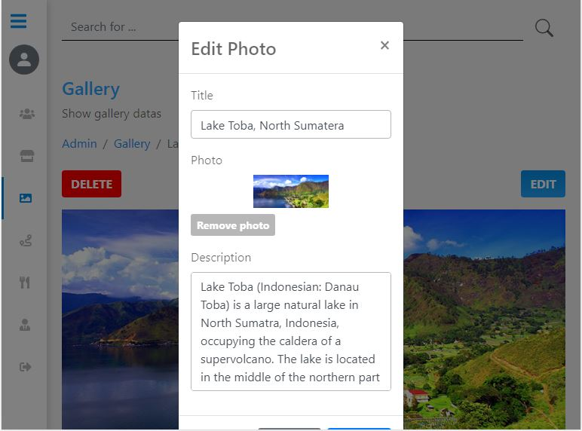
Edit Gallery Photo
Show Modal to Edit Gallery Photo

Slide 58
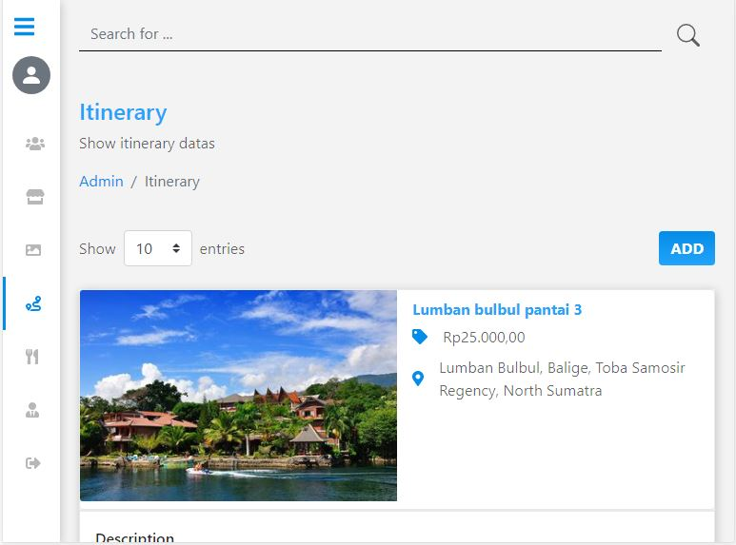
Itinerary Data
Show Itinerary Master Data

Slide 59
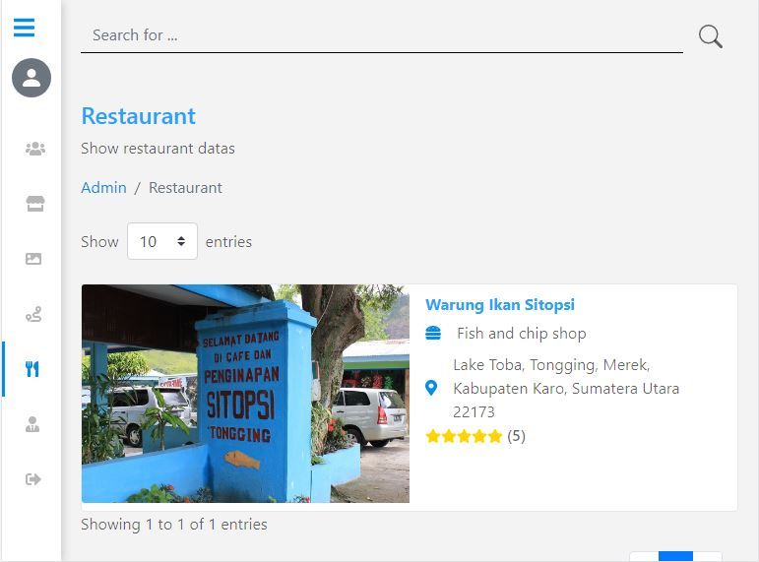
Restaurant Data
Show Restaurant Master Data

Slide 60
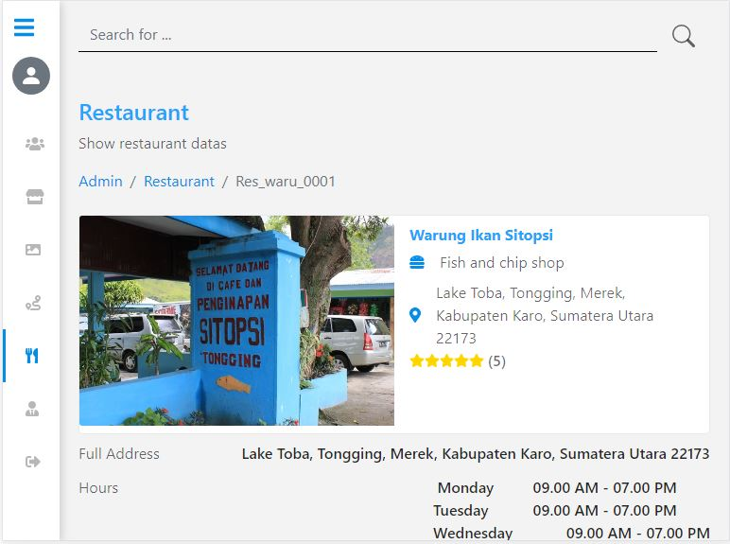
Restaurant Detail
Show Details of a Restaurant

Slide 61
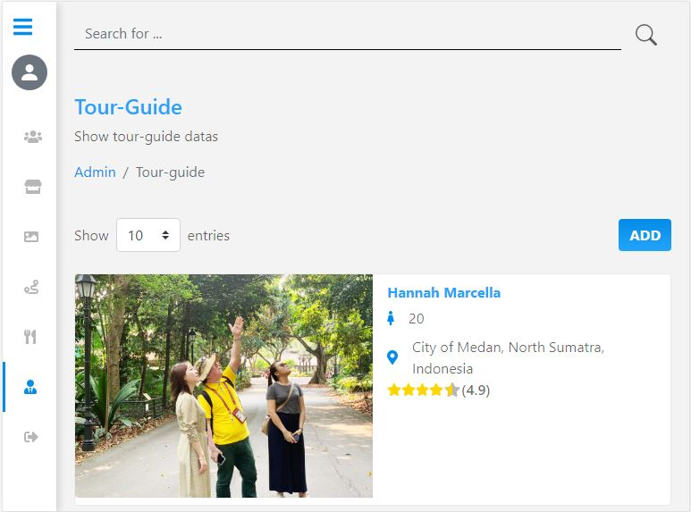
Tour Guide Data
Show Tour Guide Master Data

Slide 62
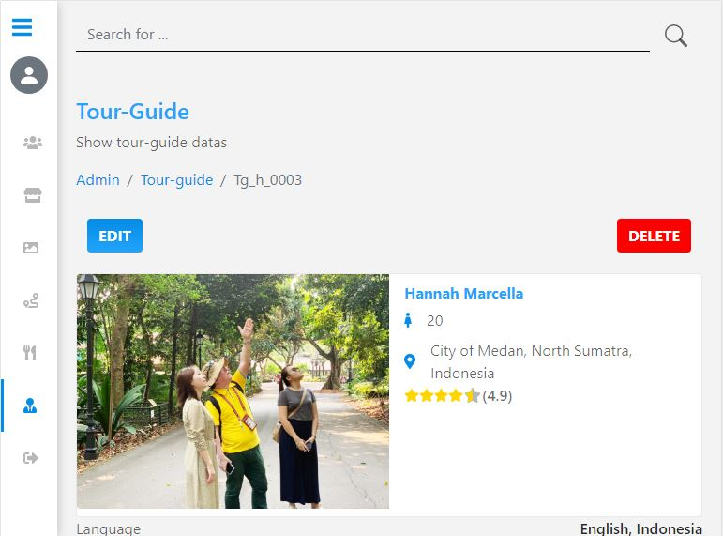
Tour Guide Detail
Show Detail of a Tour Guide

Slide 63
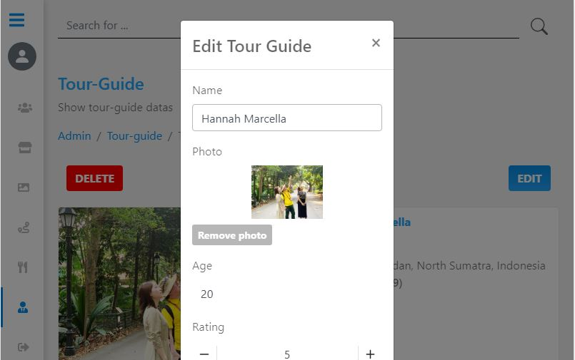
Edit Tour Guide
Edit Tour Guide Information

Slide 64
What have we done?

Slide 65
Documentation?
1
3
2
4
API Specs
Software Requirement Spesification (SRS)
Mockups
Entity-Relationship Diagram

Slide 66
















LIST OF USED TECHNOLOGY
Front-end
Back-end
Vue.js Framework
Vuex
Vue-router
Axios
Eslint
Bootstrap-vue
Vue-leaflet
Vue-qrcode
Vue-qrcode-reader
jsPDF
Nominatim OSM API
Vue-test-uitls
Java Spring Boot
MongoDB
Elastic Search
Spring Boot Reactive MongoDB
JWT
Redis

Slide 67
THANKS

